Slide 1
Predicting the Possibility of Appearance of a Cited Paper in YouTuBe Based on its Social Media Features
Srikanth Reddy Nagidi
Krishnasree Mukkavilli
Godwin Richard Thomas

Slide 2
Predicting the Possibility of Appearance of a Cited Paper Based on its Social Media Features
What is the project about?

Slide 3
Predicting the Possibility of Appearance of a Cited Paper Based on its Social Media Features
Dataset:
Altmetric Dataset was taken.
Around 100,000 published papers were taken for analysis.
70,000 → Training Set; 30,000 → Test Set
→

Slide 4



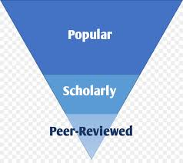




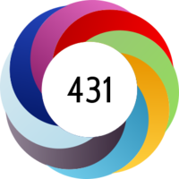




Slide 5
Predicting the Possibility of Appearance of a Cited Paper Based on its Social Media Features
Initial observations:
Imbalanced Dataset.
Smote (Synthetic Minority Over-sampling TEchnique).

Slide 6
Predicting the Possibility of Appearance of a Cited Paper Based on its Social Media Features
Feature selection:
Started with 1 feature : FaceBook.
Planned on implementing more features 1 at a time.

Slide 7
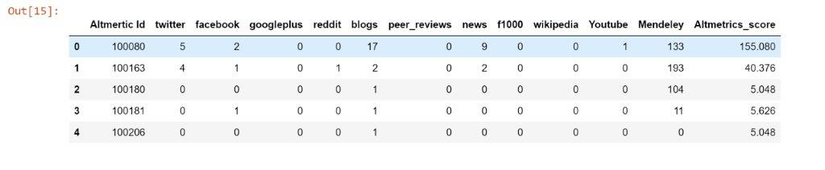
Predicting the Possibility of Appearance of a Cited Paper Based on its Social Media Features
List of Features:

Slide 8
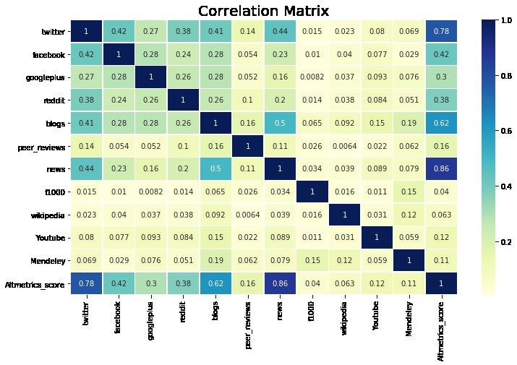

Slide 9
Classifiers:
Classifiers | Precision | Recall
KNN | 0.72 | 0.07
Decision Tree[Bagging] | 0.82 | 0.26
Random Forest | 0.77 | 0.22
Logistic Regression | 0.40 | 0.02
Logistic Regression[Smote] | 0.03 | 0.46

Slide 10
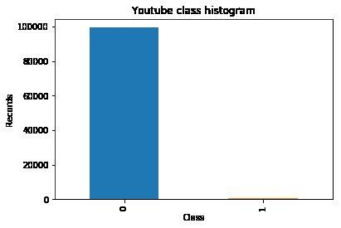
Class Imbalance Problem:
0’s : 99384
1’s : 616

Slide 11
Dealing with Imbalanced Data
Some Examples of this cases are
Credit card Frauds
Manufacturing defects
Rare disease diagnosis
Natural disasters
Balancing the classes by Increasing Minority or Decreasing majority
Random Under-sampling
Randomly removing majority class observations
Leads to loss of valuable data
May lead to bias
Random Over-sampling
Randomly adding minority class observations by replication
No information loss
Prone to overfitting due to copying the same information

Slide 12
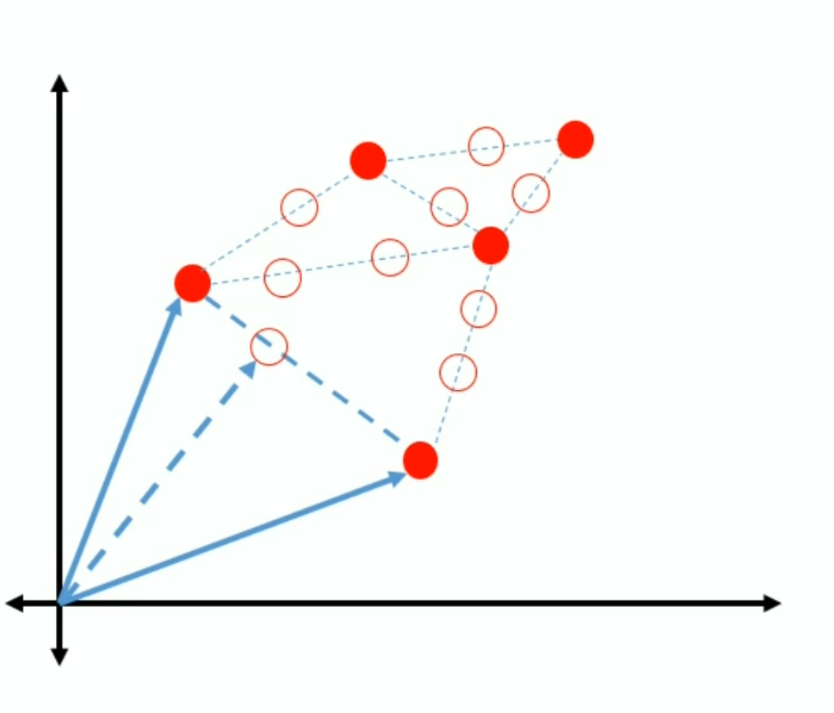
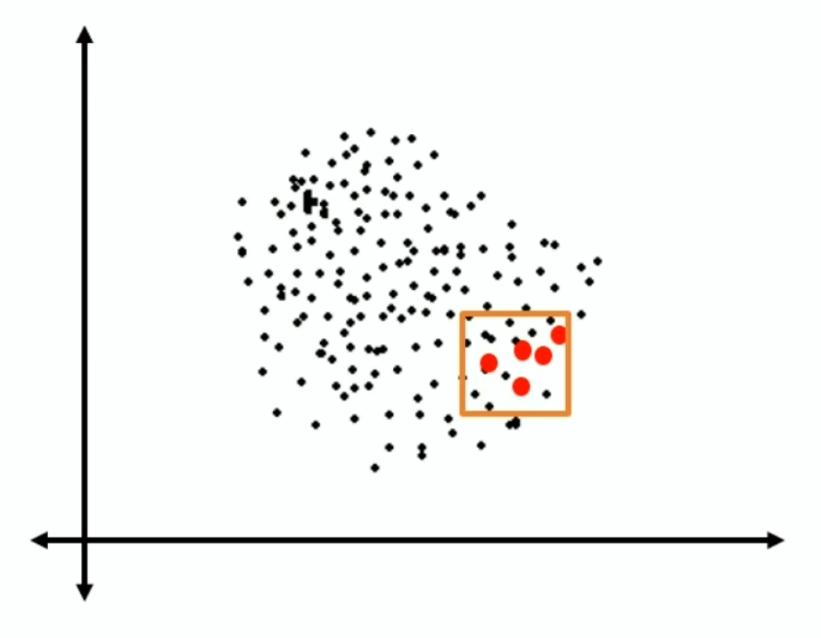
SMOTE
SMOTE - Synthetic Minority Over-sampling
Identify the feature vector and its nearest neighbors
Take the difference between two
Multiply the difference with a random number between 0 and 1
Add the feature vector to the above result
Repeat this process for all the feature vectors

Slide 13
Using SMOTE in dataset
Before Over-Sampling (training data-set):
Counts of class with label 1 (cited in youtube) : 431
Counts of class with label 0 (not cited in youtube) : 69569
After Over-Sampling with SMOTE
Counts of class with label 1 (cited in youtube) : 69569
Counts of class with label 0 (not cited in youtube) : 69569

Slide 14
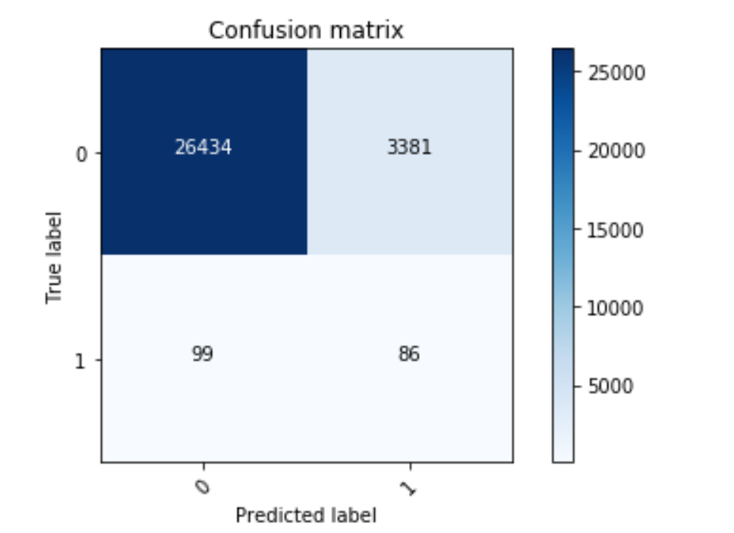
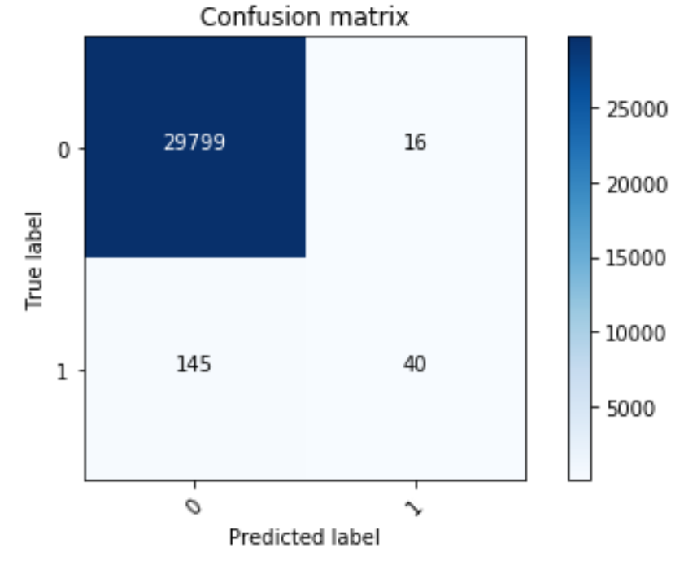
Classification
Classification by logistic Regression on the Over-sampled data
Before Over-Sampling
Recall - 0.22
After Over Sampling
Recall – 0.46

Slide 15
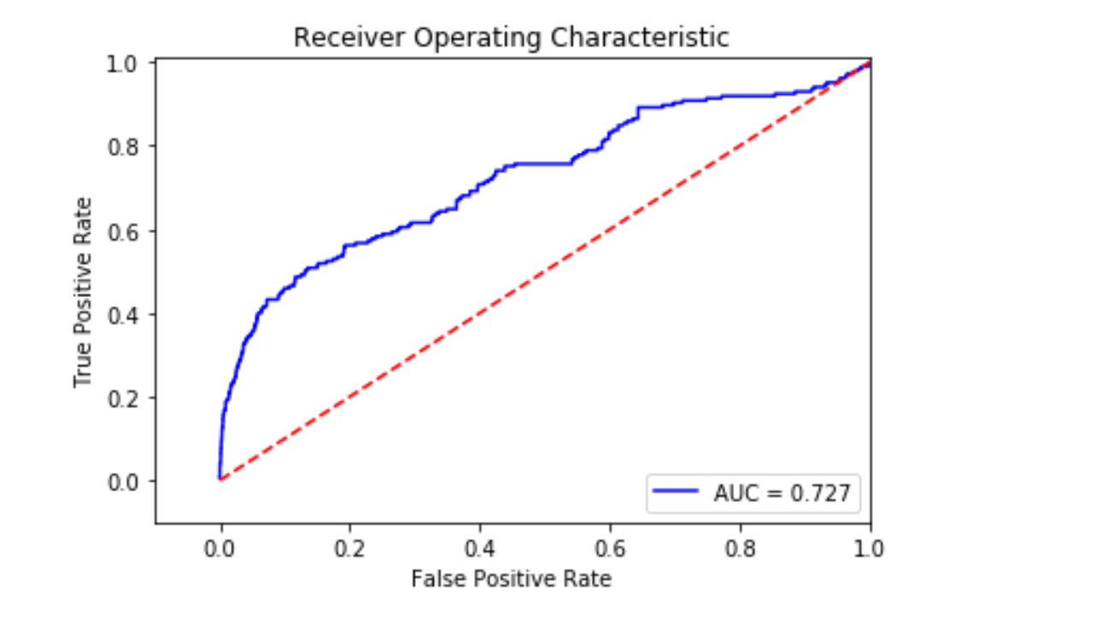
ROC
AUC – 0.73

Slide 16
Challenges
Reading the data from the datasets
Handling imbalanced data
Choosing the classifier
We wanted use SVM – takes lot of time to execute

Slide 17
Future Work
Apply the same model with entire Altmetrics dataset
Normalizing the data to avoid over fitting to improve testing results
Selecting another target for the same dataset

